Slide 1


Workflow Basics with System Center 2012 SP1 Orchestrator Andreas Rynes Datacenter Architect Microsoft Corporation
Microsoft Virtual Academy
Notes:
Welcome to this Microsoft Virtual Academy session about with Workflow Basics with System Center 2012 SP1 Orchestrator. My name is Andreas Rynes, I’m a datacenter architect within the worldwide center of excellence for private cloud and datacenter.

Slide 2
Objectives
Describe the concepts and decision processes related to workflow design and creation in OIS
Understand how to use foundation objects to control policy execution
Notes:
And today I would like to talk a little bit about the concepts and decision processes that are related to workflow design so the things that you have to think of before you start creating your workflows using Orchestrator and also to understand the foundation objects that are there helps you driving the execution of your workflows.
Objectives
Start Time 00:01 / Length: 1 minute
Microsoft Lync tools used on this page:
None
Review the learning objectives.

Slide 3
Agenda
Constructing Runbooks
Workflow Guidelines
Runbook Execution
Runbook Server
Runbook Engine Rules
Runbook Logs
Runbook Audit Trail
Notes:
So those are the main topics for today, so the agenda for today is we will cover the following topics so first of all I would like to talk a little bit about constructing runbooks, what are the things that you have to worry about, then I will cover guidelines and some tips about how to build workflows and then we will start digging into the execution of runbooks, how that works, again we will talk a little bit about the runbook server, and then we are going to cover engine rules and that’s quite an important topic to cover and after that we will talk a little bit about the logs and audit trail and how to troubleshoot Orchestrator if there are any problems.
IPv6 Subnet and Address Planning
Start Time 00:04 / Length: 3 minutes
Microsoft Lync tools used on this page:
None
Take the students through the subnet and address plan. Explain the various stages of how the plan comes together.

Slide 4
Planning and Designing a Workflow
Constructing Workflows
Identify the process that you want to automate
Ask questions about why it’s done this way
Map the process in the Orchestrator Designer
When/How often the runbook is going to run?
Which activities reflect the steps in the process?
Which type of data is required and which data is generated?
What are the results and how are the reported?
Verify the logic
Notes:
So with planning and design a workflow first of all you have to identify your process that you want to automate so you have to really plan your runbook and you should really have a defined process that you want to implement with Orchestrator so and there are a couple of things that you have to think of. So first of all how often is that runbook going to run and when does it run and how many steps are within that runbook, which activities can help you implementing that runbook and a couple of other things that you have to plan and design before really starting working with Orchestrator. And then of course you have to map the process in the Designer so for those of you who have listened to the other two sessions that we already did we covered the Orchestrator Designer, that’s actually the tool where you build the runbooks, with Orchestrator and there you have to really define how your runbook is going to look like. So and again think of how often will this runbook run, when will it run, which are the activities you’re going to really need to implement that process that’s currently a manual process for example in your data center and of course which data is required to make that runbook work and what are the results that you want to provide with your runbook and then of course you have to verify the logic and test it.

Slide 5
Building a Workflow
Constructing Workflows
Create a new runbook
Add Activities
Link the Activities Together
Configure Activity properties
Check in and test runbook
Start your runbook
Notes:
So what you do while building a workflow is really creating a runbook within the runbook Designer then you’re able to add activities, there might be scripts involved but you might just go ahead with out of the box activities, you might use an integration pack activities and then you have to link those activities together using those smart links and arrows to really build the flow and the process together and then of course you have to configure a couple of activity properties using the databus for example, using variables, using schedules, and then you have to check in the runbook and test it and then of course you’re able to start your runbook using the runbook Designer or go ahead and using the Orchestrator console to start your runbook.

Slide 6
Runbook Guidelines
Building and Organizing Runbooks
Numbering and Naming
Runbook Usage
Check in/out, Comments
Start/Stop
Testing
Orchestrator Console
Failure Handling (using links and color them)
Don’t use default labeling
Consider splitting runbooks
Logging (Orchestrator/External)
Notes:
So couple of guidelines, how to build your runbooks, one thing you have in the Runbook Designer on the very left side you have a folder structure which is very familiar with Windows Explorer so you’re able to organize your runbooks in folders and of course you’re able to name those runbooks and also add numbers to that. So if you runbook or the process that you want to automate consists of more than just one runbook you might use numbers to identify which runbook is starting first and coming next and so on so that you’re able to really understand the logic behind the different runbooks.
So from a runbook usage perspective there’s a concept of checking in and checking out your runbooks so as soon as you want to start or edit an existing runbook or start a new runbook you have to check out that specific runbook so then you can go ahead and edit and create that runbook. And as soon as you’re done with that you’re able to check in the runbook and as soon as your runbook is checked in it’s able to run on your runbook service so with every check in and check out you can write some comments, you have the option to start and stop that runbook with in the Designer or even using the test tool and of course you are also able to use the Orchestrator console to start and stop your runbooks.
One interesting and very important thing is to think about failure handling so some logic around what happens if an error occurs in your runbooks and that’s pretty important to have one central way how to handle errors within your runbook and one good thing is using colored links so you’re able to color the links that you’re going to use and that you’re able to see without digging any deeper to see which part of the runbook is for error handling. So you’re able to color those links and you’re able to use labels for that.
So and of course one another important concept is using splitting runbooks so whenever you think of a specific process that you might use more than just one time think of using separate runbook and use that runbook in all the other runbook as child runbooks so for example if you want to, error handling is actually a very good example for that so if you think about some generic error handling where you are accepting some parameters like the error code and some error text and then create for example an incident within Service Manager you’re able to really do that in one runbook and then use that runbook in all your other runbooks to make error handling happening in a very consistent way in all your runbooks so that’s all about how to split runbooks. So I think tha’ts also a very important concept to think about before creating your runbooks.
And of course you’re able to use logging so either within Orchestrator and also externally that helps you to find out the status and to troubleshoot problems with your runbooks.

Slide 7












Runbook Execution
11
Designer
001010
PolicyModule.exe
001000
001110
Console
<XML>
<XML>
Management
Service
GUI
Data Store
Runbook Server
(Design, manage, report)
(Store process logic)
(Run processes)
Notes:
So from a runbook execution perspective, from the Designer you’re design your runbooks there, those will go through the management service to the database, to the data store, the Orchestrator’s SQL Server database and the runbook service grab those data the runbooks into the runbook server and execute them there and also updated the status back to the data stores. So whenver a runbook server runs an instance of one of your runbooks will pass back information to the data store about the status and the console which you see on the left side will grab that data from the data store and make it visible to you in the console so that you’re able to see real time information about all the instances of your runbooks.

Slide 8

Runbook Server
Runbooks run on the Runbook Server
Communicate with the Datastore
Installation Options
Typical Install via Deployment Manager
Manual Install via the MSI
Runbook Servers
Management Server
Datastore
Deployment Manager
Notes:
So again the runbook server is that service that runs your runbooks and it will communicate with the data store so even if the management server is not available the runbook server really communicates directly to the data store. And actually there are two ways to deploy runbook server, so first of all and the first choice is using the deployment manager, that’s a tool that’s part of System Center 2012 Orchestrator and you’re able to deploy the runbook service with that tool.
And another way is to do a manual install using MSI package. So the deployment manager is there for not only deploying the runbook service but you’re also using that deployment manager to deploy integration packs for example so whenever your runbook is using a specific integration pack you have to deploy that integration pack to your runbook service as well. And therefore Deployment manager is there to help you in doing that and the runbook service again are communicating with the data store to grab a copy of your runbooks, copy that to the runbook server itself and run it there locally and push back information to the data store about status and so on.

Slide 9
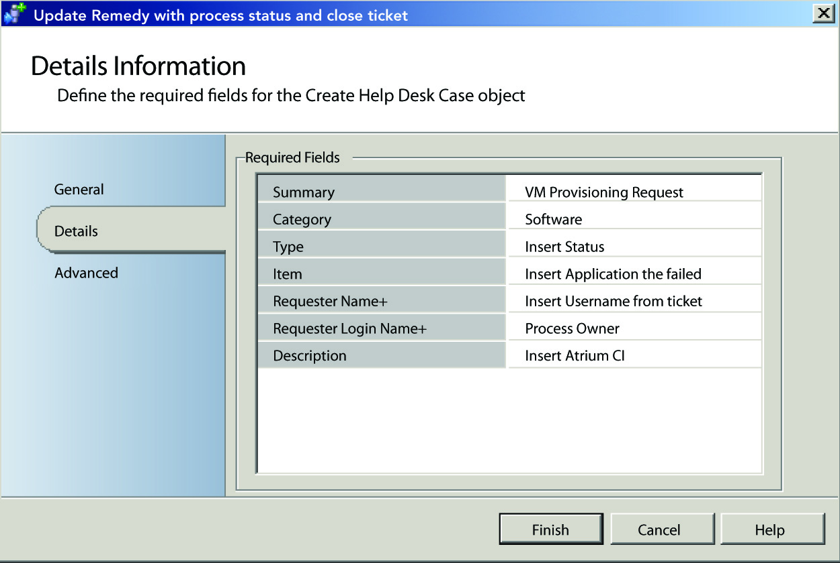
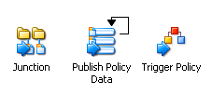
Runbook Engine Rules
Publish data
Multi-value data
Links
Branching
Junction
Flatten
Data mapping
Looping
Nesting Runbooks
Notes:
So there are a couple of runbook engine rules that I would like to discuss in a little bit more detail first of all publish data, so publish data really let’s you use information from a specific activity in another activity within the same runbook. So, and each activity has a set of publish data so whenever an activity runs after it runs, it publish that data to the data bus and the next activity is able to use that data. And all activities are also publishing a common set of data, items like the start and stop time of the activity, and the completion status so that’s common for all the activities and then of course you have a set of data items for each activity that’s different. And also link condition are also using publishing data to add filtering and decision making capabilities to runbook. So that’s all about publish data.
Another engine rule is multi-value data, so when an activity runs in a runbook it runs one time for each item of the data that the previous activity previews so a very good example for that is, think about querying of database, so whenever you want to query your SQL Server for example and that retrieves ten rows from your database those ten rows will be passed to the next activity and the next activity will run ten times so that’s how multi-value of data is working in Orchestrator. For that you have a concept called flatten I will cover that in a moment.
So the next one is links, we have already discussed it a little bit so links are those errors that’s connecting the activities in your runbook and these errors are called links or smart links and they will help you to decide the flow of your runbook and to decide whether or not to run the next activity. So if you go and double click on those links so there will be a window where you will be able to enter some filter information. and that will be used also for branching which is one of our next engine rules or concepts within Orchestrator.
So whenever you want to branch or split the path of your runbooks you have to add multiple links to your activity and just create a new link by just dragging from your start activity and drag it to the start of your second path and you do some branching there. and you can define the folders, you’re able to use include and exclude statements using variables and also of course accessing the publish data on the databus and there are filter conditions like ink log, panes and start with and of course you can define values for that. So for example for monitor a folder and trigger the next activity for both change and delete the files from within that folder and there you can split your workflow and define different activities for either change or delete triggers. And of course what I mentioned before in the guidance use links and label within your smart links that will help you really to understand what’s going on in your runbook.
So another concept is called junction and that comes hand in hand with the branching idea or concept, so a junction idea or activity allows you to multiple branches in a runbook to complete so this activity can also publish data from any branch so that all the activities that comes after that junction or after that branch are able to consume that data that the junction activity is publishing to the databus. So if you think of having a couple of branches to do maybe different things at the same time, you want to bring them together those different branches and then go ahead with just a single thread where all the other activities will happen so that’s where junction comes into work.
So the flatten concept I’ve already mentioned that in the multi-value datas so when you think about that example with SQL server where you query database and you will get back a couple of results you are able to flatten that and so this invoked next activity as many times as there are items to output and if you don’t want that you’re able to use the flatten property that’s part of the activity and you’re able to provide a single output for that activity. And there are a couple of different options, you can either separate that with line breaks or separate that with a specific character that you can define or you’re able to use a CSV format as well with that flatten option.
Another concept is the data mapping so the data mapping you’re able to transform existing publish items or variables into new values according to whatever rules you are going to specify so if for example you want to convert numeric values to broad values you’re able to use that map publish data activity to do that.
Another concept is looping so let’s say that you want to have a process or a activity run several times so example for that might be checking for status of a specific service that’s running on a remote server and you want to check if that service is running or not so you want not only to check it once but check it for a couple of times, let’s say five times in within every ten seconds so you have to use looping so you’re defining that on the activity but you can also define that on a runbook level so not only on activity level and you can define exit and do not exit conditions like for example number of attempts or a specific publish data or specific variable if that’s true if you want to exit or you do not want to exit that loop and with that you’re able to implement things like checking for status of specific service for five times every ten seconds.
So the last concept I would like to cover is nesting runbook so I’ve already discussed it in our last session but I would like to do it again so you’re able to start runbooks within a runbooks so you have some sort of parent child relationship. One example which I mentioned before is the error handling idea so that you have specific runbooks in your environment that takes care about the error handling. And then you’re able to call that error handling routine or that error handling a runbook within all your other runbooks so that’s all about nesting runbooks and you’re able to do that by using the invoke runbook activity where you’re also able to define passing parameters to that runbook and also returning parameters or values from that child runbook back to the parent runbook.

Slide 10
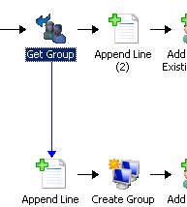
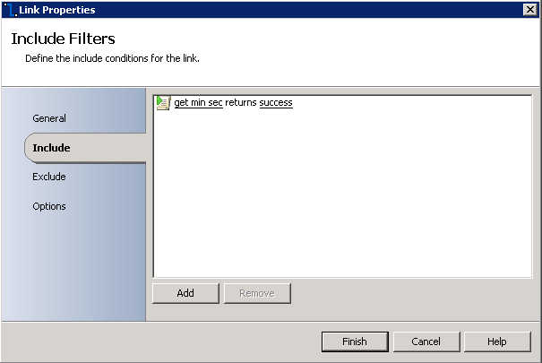
Published Data
Published Data lets an activity use information from another activity in the same runbook
Set of data is specified by activity
Plus common set of data items for all activities (e.g. start/stop time)
Link conditions also use Published Data to add filtering and decision-making capabilities

Slide 11
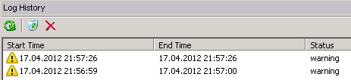
Logs
Every runbook generates a log
Real-Time Log
Historical Log
What is Logged?
Start and end times and completion status
Runbool level
Activity level
Published Data (if configured)
Notes:
So how do you work with logs within Orchestrator, so every runbook generates a log so first of all you have a real time log where it shows you real time information about current running runbooks so when they have started what are actually the activities that run currently and then you also have the same information for historical runbooks so for every runbook that run in the past there is a historical log entry that tells you when that was started, when it ended, the status of that specific instance and if you double click on that in the historical log you will see all the activities and their status as well. So again there is start and end times, completion status, and that’s done on a runbook level activity level and also the published data so you’re able to get information about the published data in the logs as well.

Slide 12
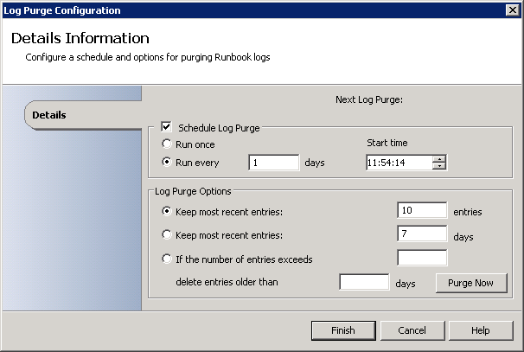
Purging Logs
Regularly purge old log entries
Scheduled (default) or manual task
Frequency (e.g. one time per day)
Retain (keep last 10 entries)
Time (e.g. 2am)
Notes:
So those logs are stored in the data store, in the SQL data store so you’re able to purge those logs and you should do that regularly so you’re able to define schedule and you can do it manual by just clicking the runbook designer, there is actually one entry in the menu that tells you to purge the logs but you should design and create a schedule that this will happen for example every day in the night and only keep the last couple of entries for troubleshooting but better do that everyday probably during the night to purge those logs that they don’t fill your data store.

Slide 13
Trace Logs
Orchestrator can create trace log messages
Help you identify problems (Management server)
By default only for exceptions
Trace Log location: ProgramData\Microsoft System Center 2012\Orchestrator
HKEY_LOCAL_MACHINE\SOFTWARE\Wow6432Node\Microsoft\SystemCenter2012\Orchestrator\TraceLogger
LogFolder, LogLevel, LogPrefix, NewLogEvery (seconds)
Notes:
And there are also trace logs available so Orchestrator is able to create those message in a trace log, it will of course help you to identify problems with your Orchestrator environment by default those are only created for exceptions but you can define that so there is actually a registry folder that has a couple of entries like the log folder, log level and prefix and how often your logs should be created and with that you are able to control the way Orchestrator is creating those trace log messages.

Slide 14
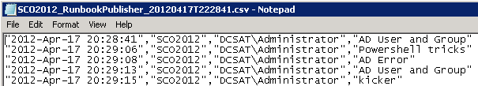
Runbook Audit Trail
Collection of text log file with info on runbook interaction with external tools & systems
Not activated by default
To activate the Audit Trail: atlc /enable
To deactivate the Audit Trail: atlc /disable
What is Logged?
Who and what started the runbook
Configuration data from each object
NOTE: Can consume a large amount of disk space
Notes:
And there’s actually a runbook audit trail, it’s a collection of text log files with information about your runbook interaction with both external tools and systems so everything that will communicate with you in Orchestrator will be stored in those text log files.
So those runbook audit trail is not activated by default so if you want to activate that or deactivate that you’re able to do that on the command line with that command here on that slide deck.
So what information is actually logged in those text log files? First of all who and what started the runbook and also configuration data from each object so that’s actually quite interesting information but you need to think of when to activate that audit trail because that really will consume a large amount of disk space so think twice before you activate it and don’t forget to deactivate it if you’re done with that.

Slide 15
Summary
Discuss guidelines for constructing runbooks
Understand runbook engine rules
How to manipulate runbook execution with junctions, looping and flatten
How to enable & disable the runbook audit trail
Difference between Historical and Runtime log
Notes:
So with that we are closing that session so we have discussed a couple of guidelines for how to construct runbooks.
We’ve discussed quite a bit about some engine rules and how to manipulate runbook execution with junctions, looping, how to flatten output and also how to troubleshoot your Orchestrator environment and how to enable and disable the runbook audit trail and also what is the difference between historical and runtime log.

Slide 16
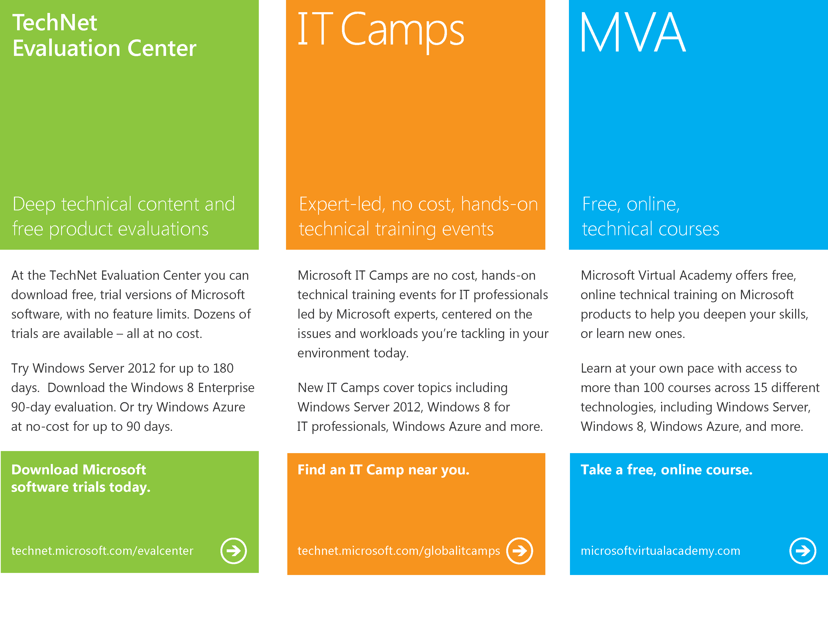
Notes:
So thanks for joining today, I want to close with just give you a couple of more information about where to find information around Orchestrator and Microsoft products and technical learnings. So first of all go to TechNet evaluation center, you’ll find a couple of free trial versions of Microsoft software at no cost and there are no feature limits and then there are also technical trainings available for IT pros on technetmicrosoft.com/globalitcamps and of course the Microsoft Virtual Academy which you will find on microsoftvirtualacademy.com
Thanks for joining today and see you soon in the next session about Orchestrator.

Slide 17

© 2012 Microsoft Corporation. All rights reserved. Microsoft, Windows, Windows Vista and other product names are or may be registered trademarks and/or trademarks in the U.S. and/or other countries.
The information herein is for informational purposes only and represents the current view of Microsoft Corporation as of the date of this presentation. Because Microsoft must respond to changing market conditions, it should not be interpreted to be a commitment on the part of Microsoft, and Microsoft cannot guarantee the accuracy of any information provided after the date of this presentation. MICROSOFT MAKES NO WARRANTIES, EXPRESS, IMPLIED OR STATUTORY, AS TO THE INFORMATION IN THIS PRESENTATION.

